Slide 1
Welcome All
To the Optimized World of Web Development

Slide 2
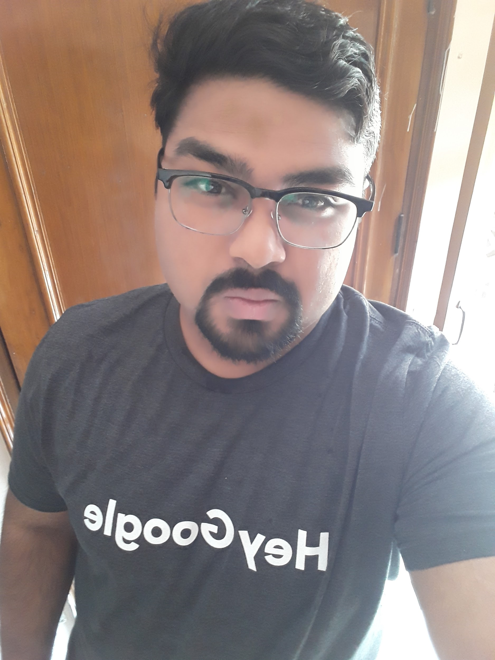
Who I AM ???
Jitender Kumar
4th Year B. Tech(CSE) Student
An ML Enthusiast
Have Worked in most of the Domains of Technical field
LinkedIN - https://www.linkedin.com/in/jitender-kumar-1b8368148/
Github - https://github.com/Jitender46559

Slide 3
Web optimization

Slide 4
How we can achieve optimization in websites ???
Squeeze your images with the help of some oftenly used online tools.
Always make a habit to make a separate javascript file so that load on the servers at the time of loading web pages is got reduced.
Always remove the white spaces in your JS file, CSS and HTML file and PHP file also.
Always try to save the images in the different folders so that your servers are not overloaded.

Slide 5
Tools that i have used so far
For Images - https://squoosh.app/, https://images.guide/
For JavaScript - https://codebeautify.org/jsviewer
Get Deep Insights of your webpage - https://developers.google.com/web/tools/lighthouse/#devtools
Test WebSites as Game - https://perfgame-206511.appspot.com/
Web Page Tester - https://www.webpagetest.org/
Page speed ups Insights - https://developers.google.com/speed/pagespeed/insights/?url=https%3A%2F%2Fwww.kccitm.edu.in%2F
Various tools offered by Google - https://developers.google.com/web/tools/
Training by Google - https://developers.google.com/web/

Slide 6
What i need from you guyzzz
???

Slide 7
Thank you

